Slide 1
Internal Signage Update

Slide 2
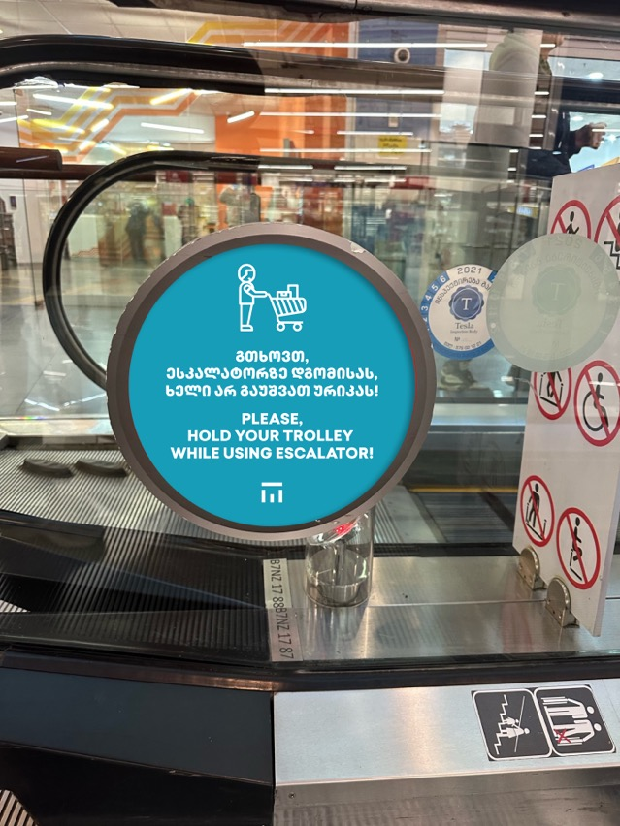
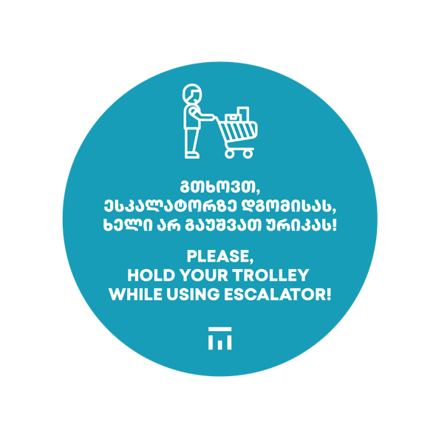
Features:
35 cm diameter
38 pcs of stickers

Slide 3
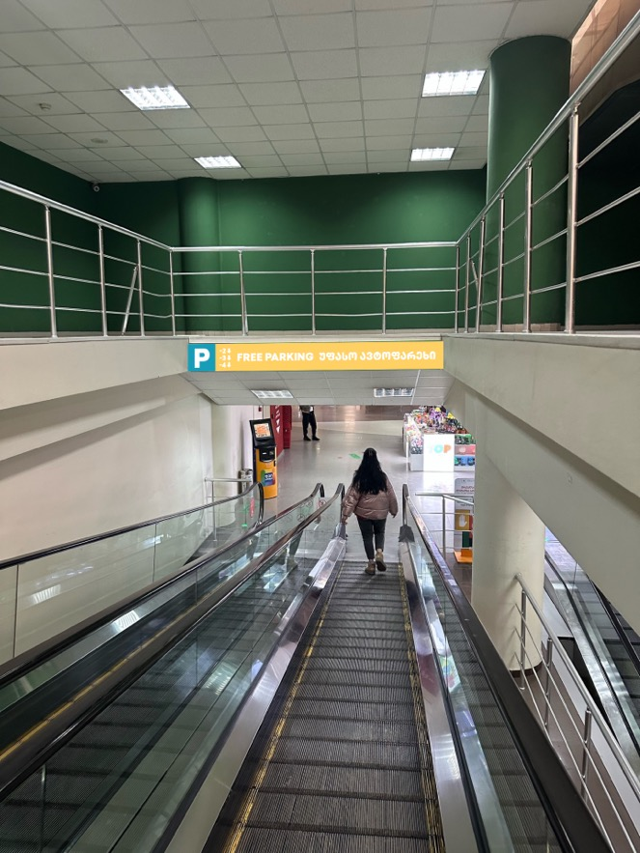
Features:
300*34 cm
Dibond/Pvc
1 pc

Slide 4
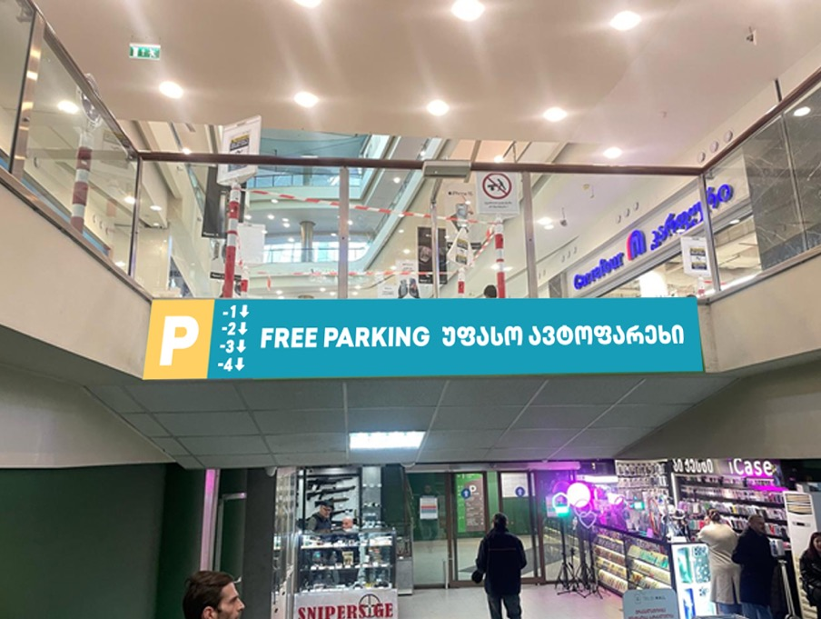
Features:
307*39 cm
Dibond/Pvc
1 pc

Slide 5
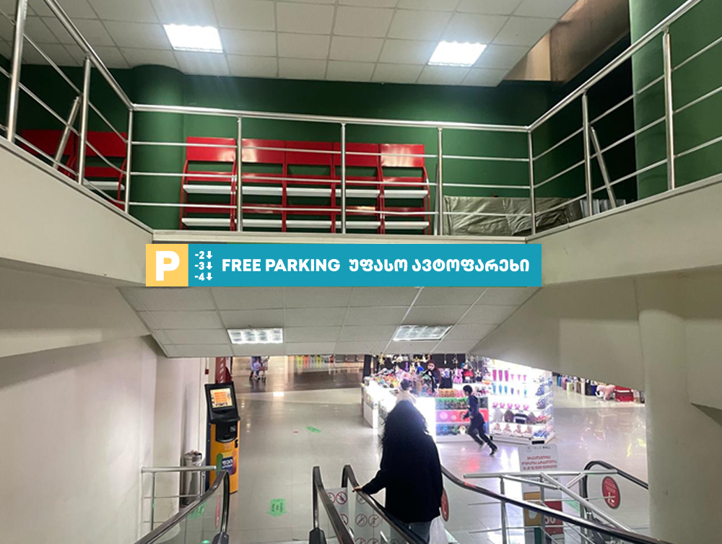
Features:
300*34 cm
Dibond/Pvc
1 pc

Slide 6
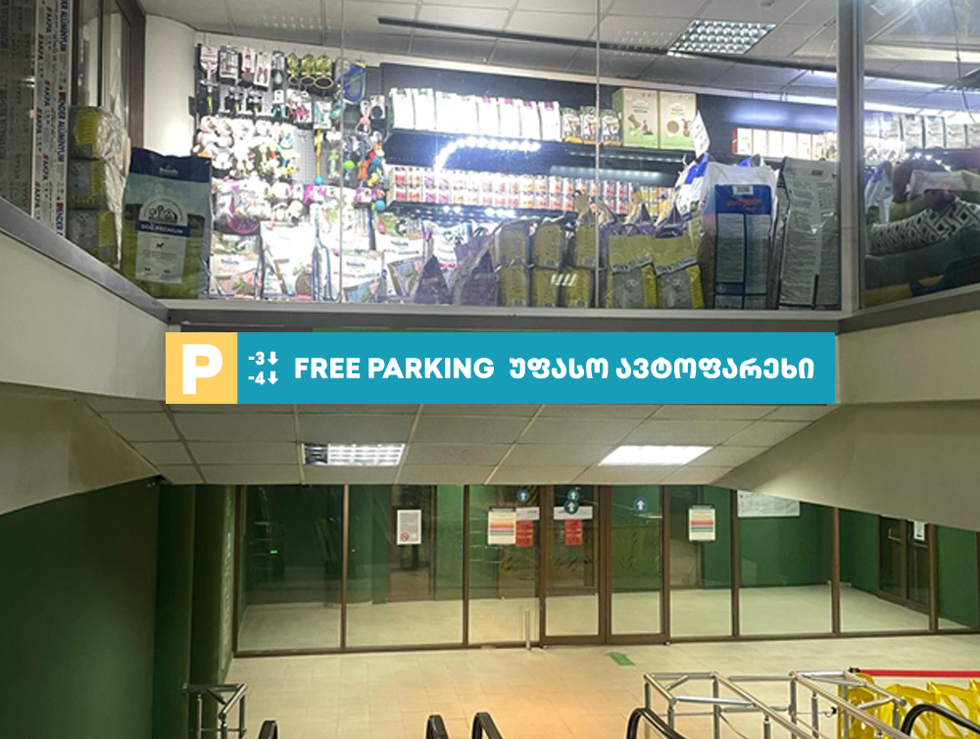
Features:
298*34 cm
Dibond/Pvc
1 pc

Slide 7
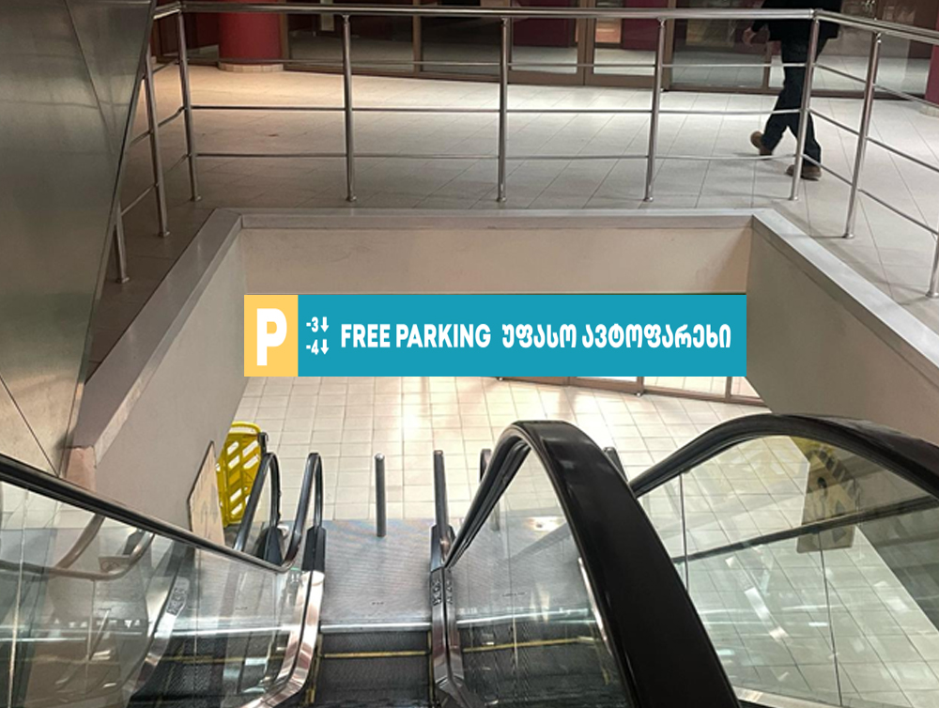
Features:
274*46 cm
Dibond/Pvc
1 pc

Slide 8
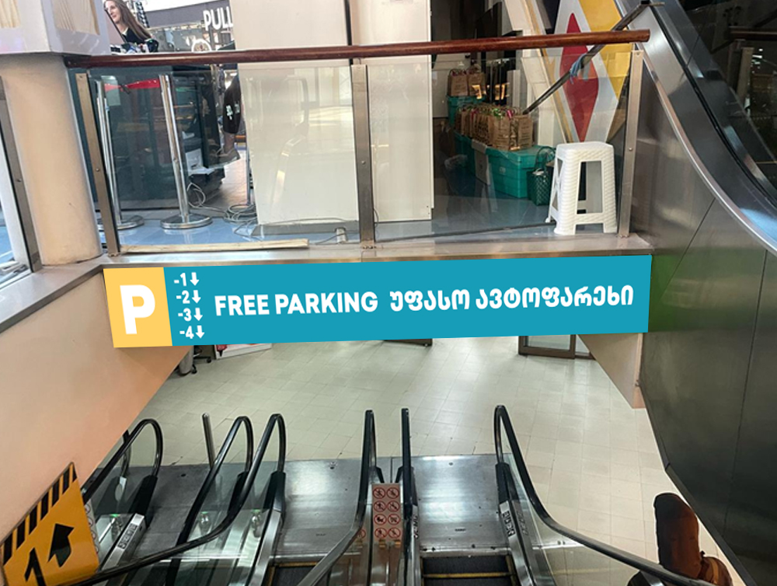
Features:
275*41 cm
Dibond/Pvc
1 pc

Slide 9
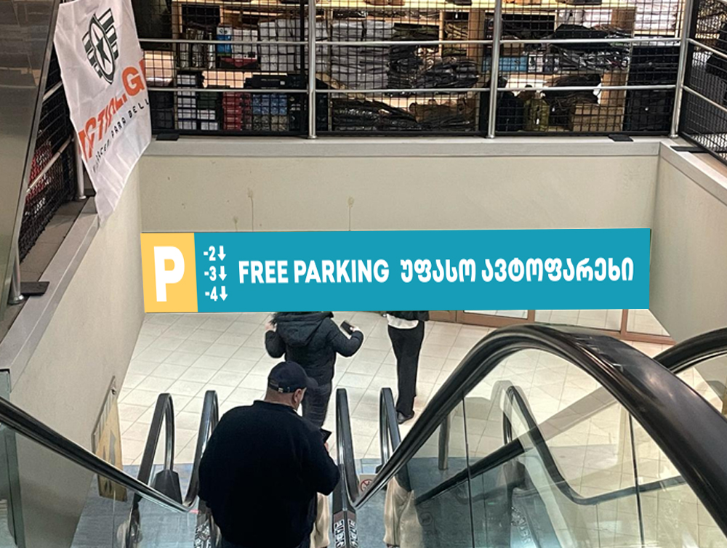
Features:
279*46 cm
Dibond/Pvc
1 pc

Slide 10
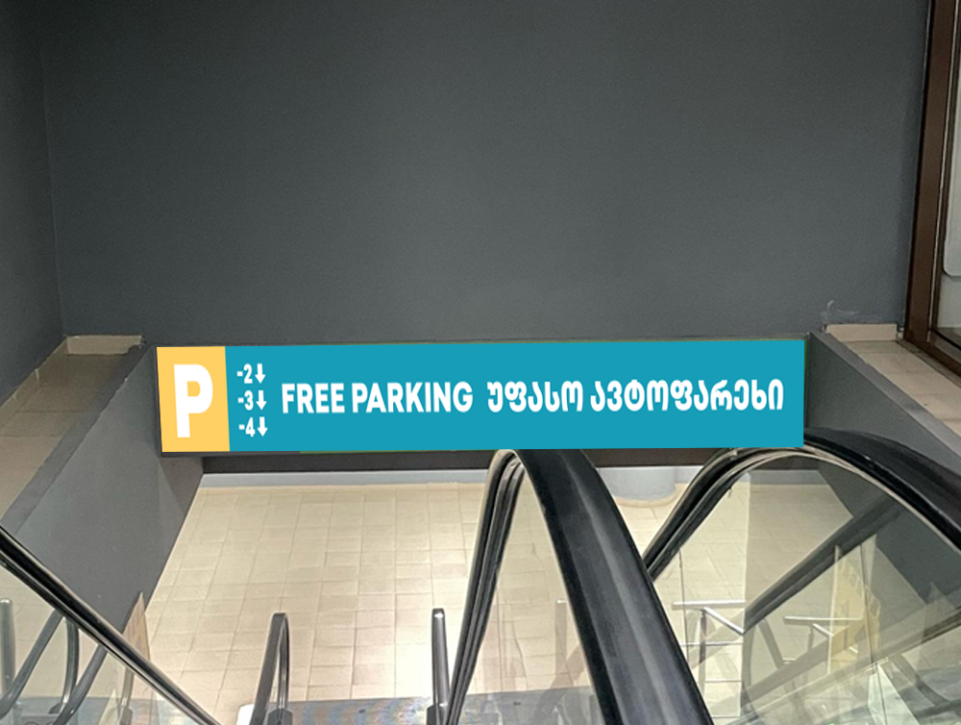
Features:
270*28 cm
Dibond/Pvc
1 pc

Slide 11
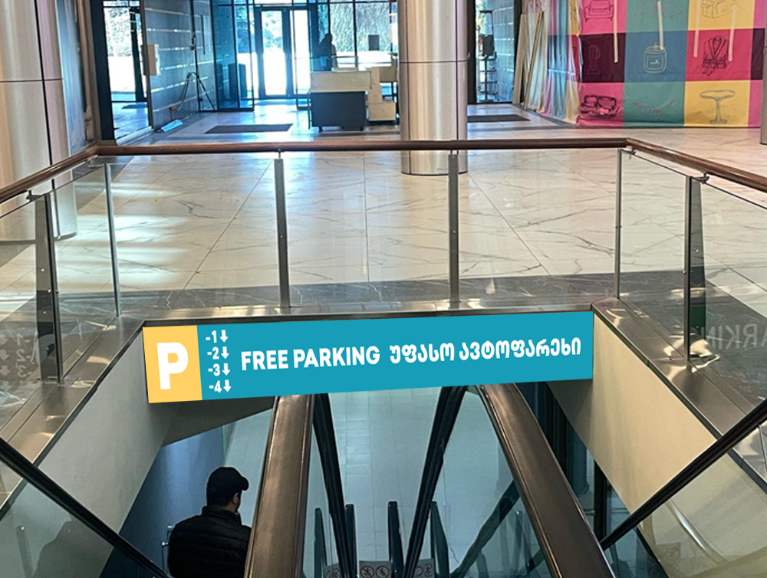
Features:
264*41 cm
Dibond/Pvc
1 pc

Slide 12
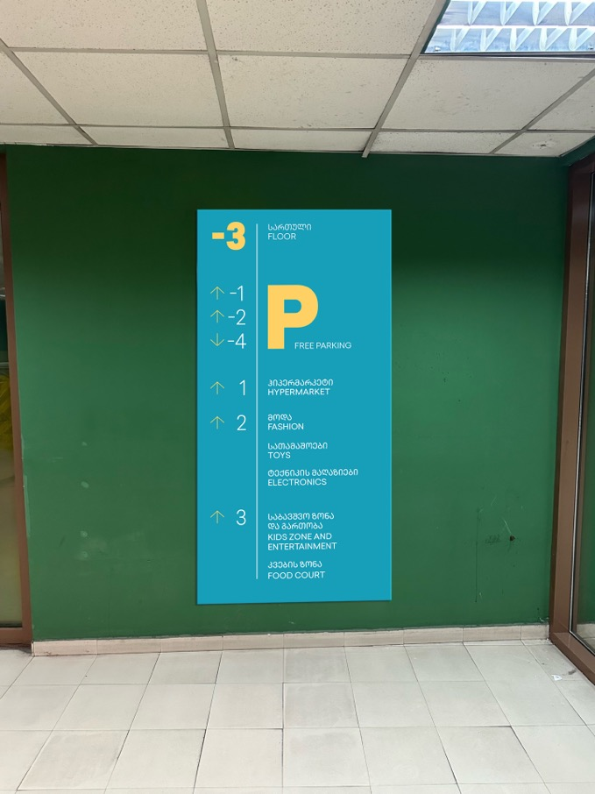
Features:
91*198 cm
Dibond/Pvc
1 pc

Slide 13
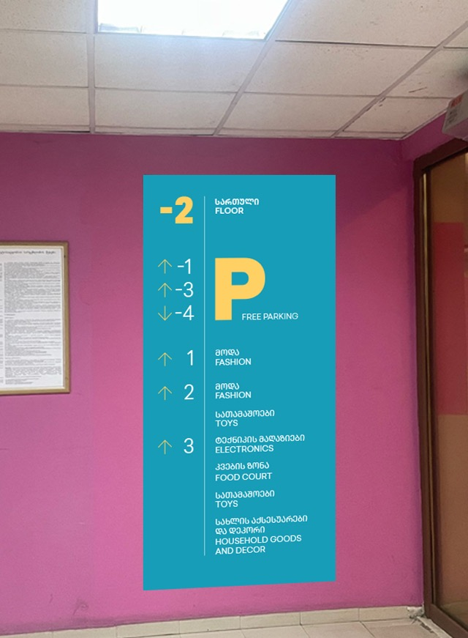
Features:
91*198 cm
Dibond/Pvc
1 pc

Slide 14
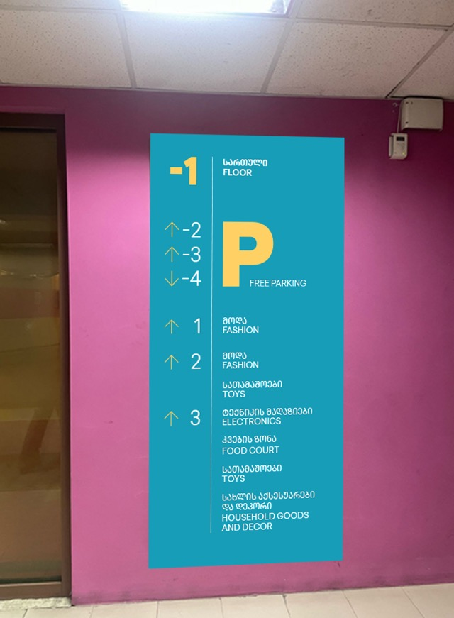
Features:
91*198 cm
Dibond/Pvc
1 pc

Slide 15
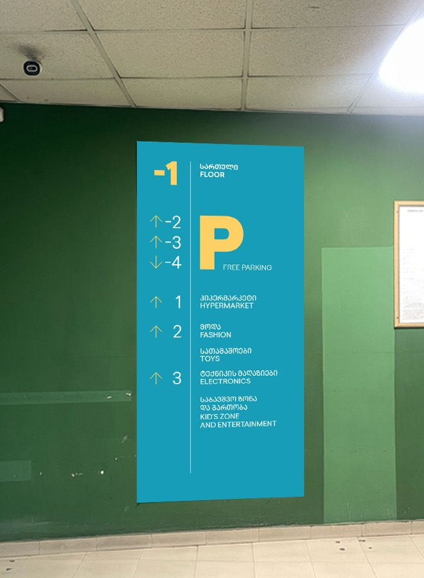
Features:
91*198 cm
Dibond/Pvc
1 pc

Slide 16
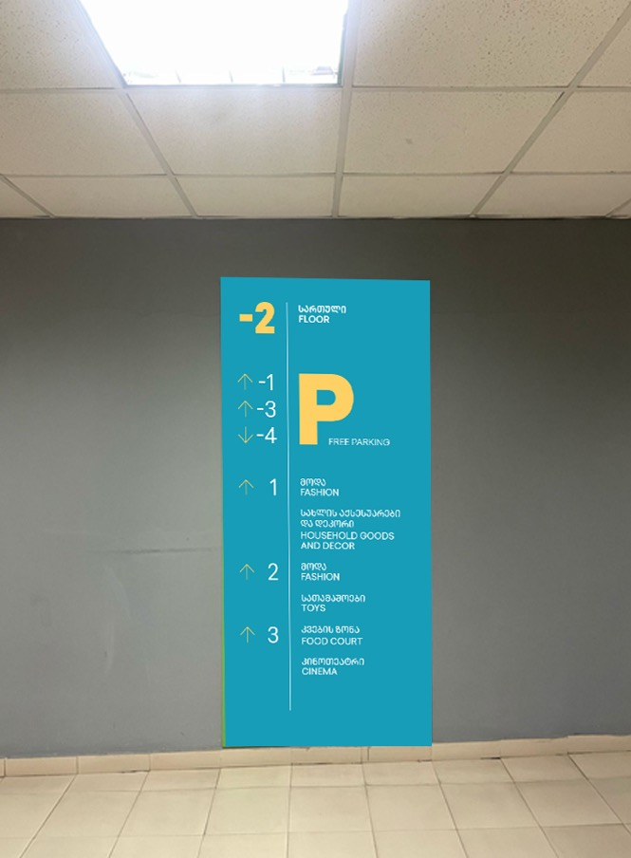
Features:
91*198 cm
Dibond/Pvc
1 pc

Slide 17
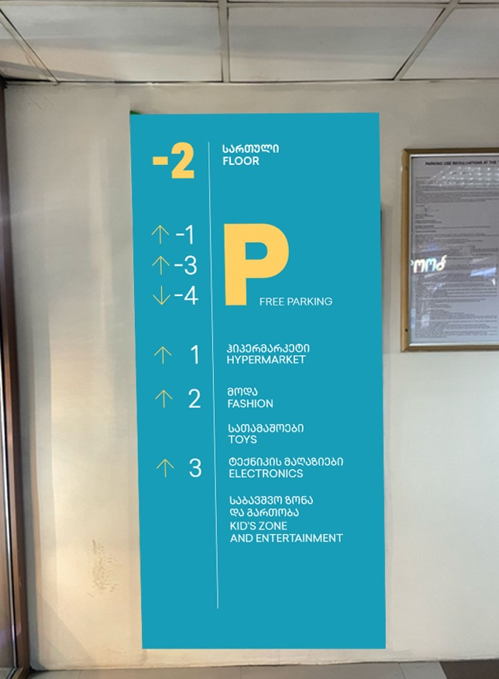
Features:
91*198 cm
Dibond/Pvc
1 pc

Slide 18
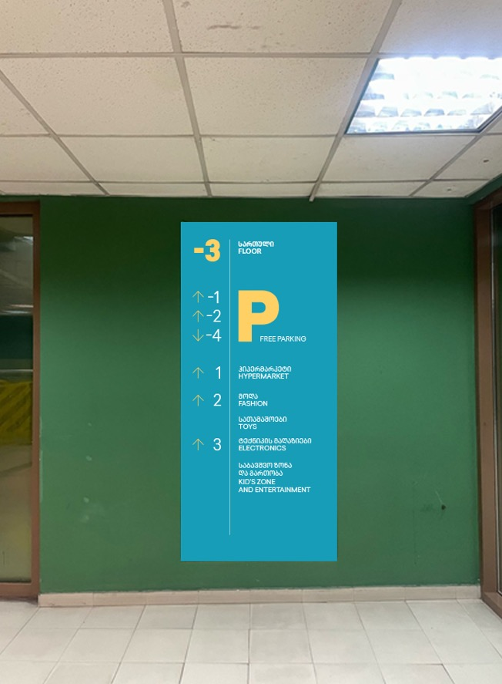
Features:
91*198 cm
Dibond/Pvc
1 pc

Slide 19
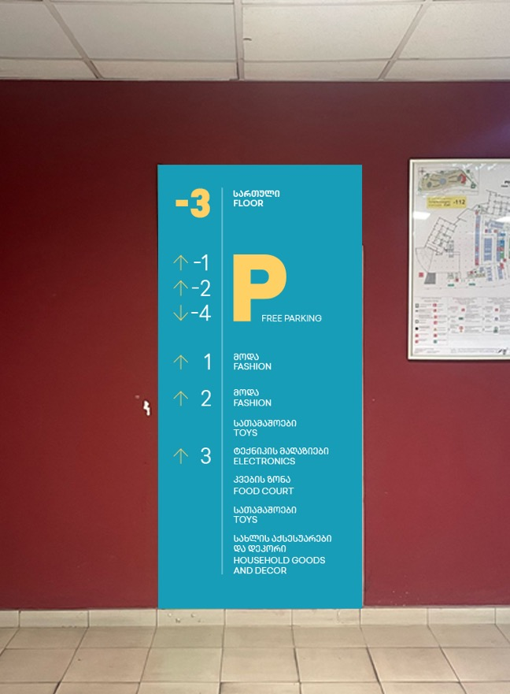
Features:
91*198 cm
Dibond/Pvc
1 pc

Slide 20
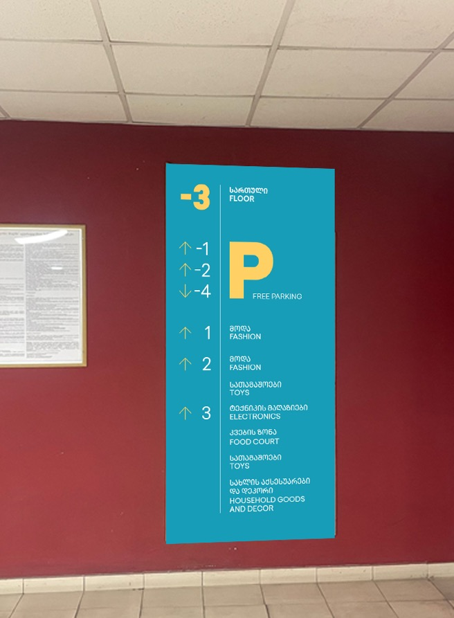
Features:
91*198 cm
Dibond/Pvc
1 pc

Slide 21
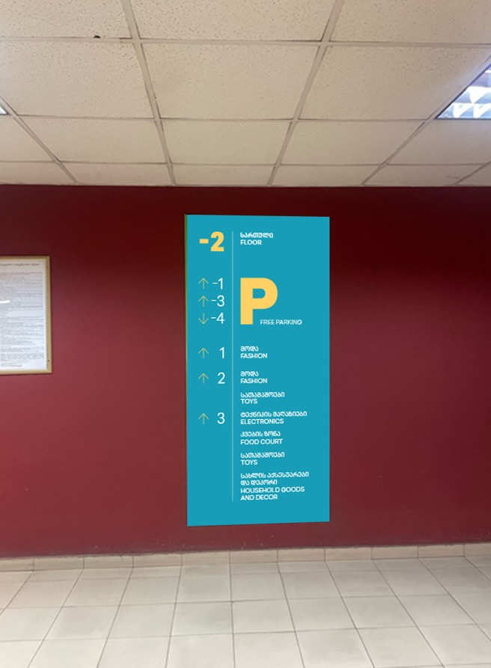
Features:
91*198 cm
Dibond/Pvc
1 pc

Slide 22
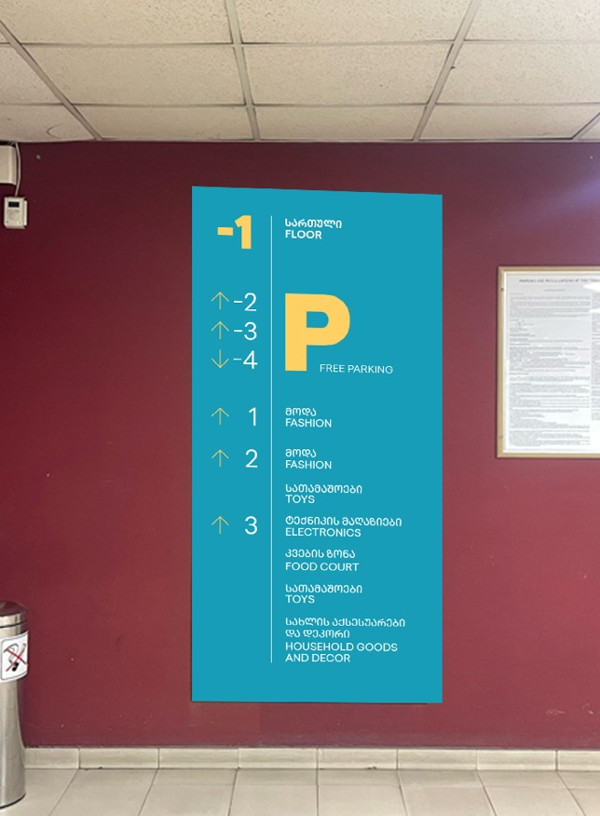
Features:
91*198 cm
Dibond/Pvc
1 pc

Slide 23
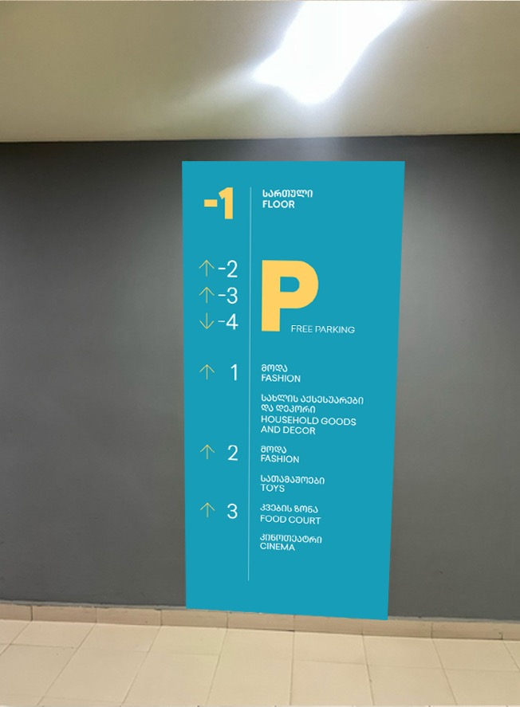
Features:
91*198 cm
Dibond/Pvc
1 pc

Slide 24
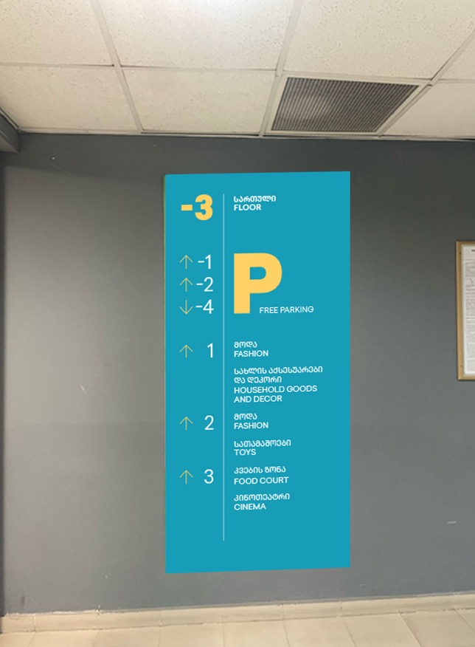
Features:
91*198 cm
Dibond/Pvc
1 pc

Slide 25
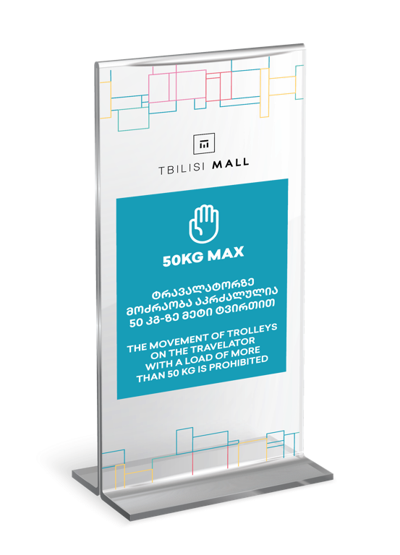
Features:
88*49 cm
Dibond/Pvc
2 pcs
Transparent sticker on escalator glass and similar construction.

Slide 26
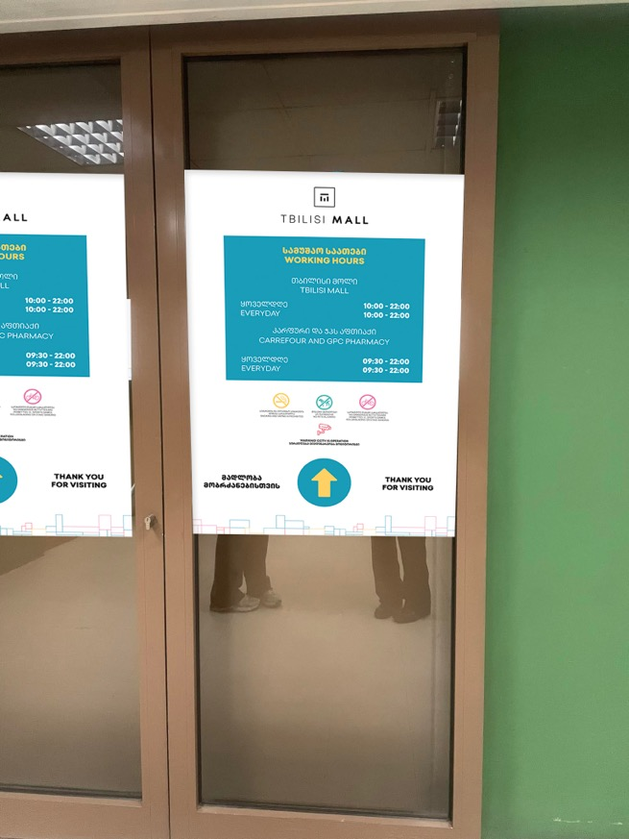
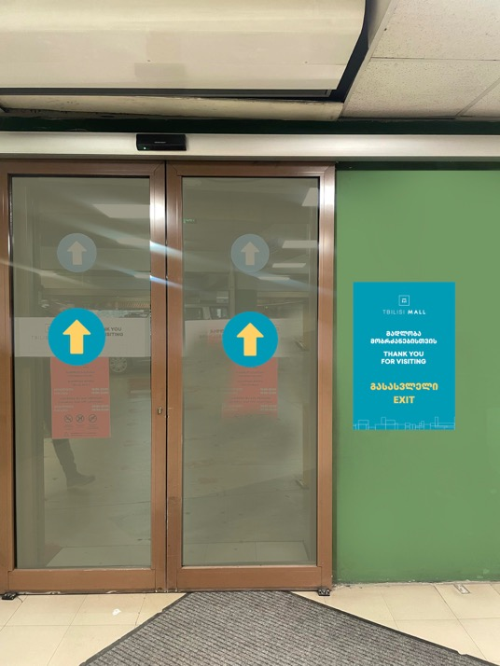
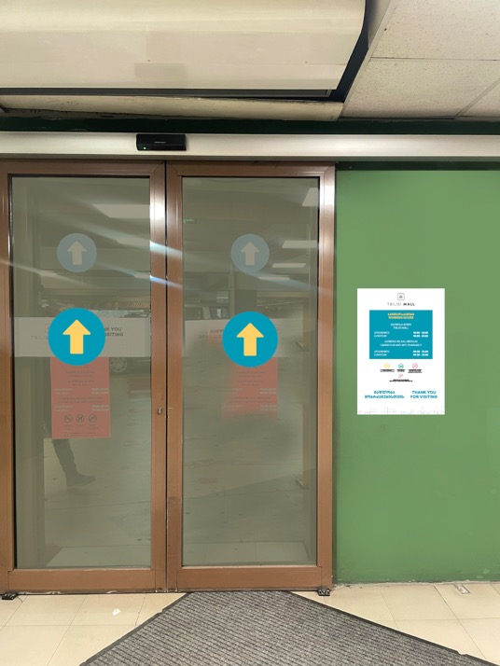
Features:
88*49 cm
Dibond/Pvc
161 pcs

Slide 27
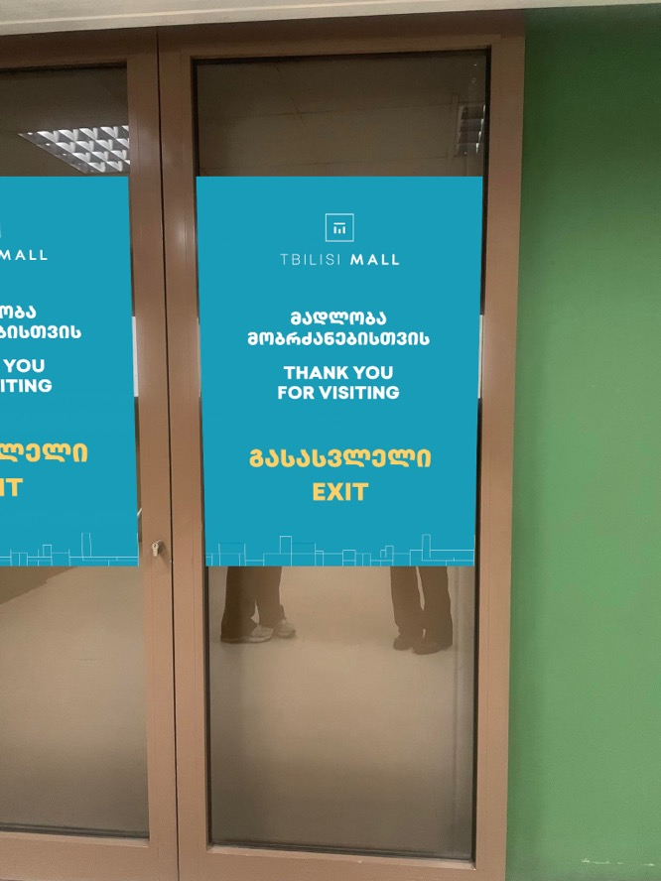
Features:
70*100 cm
Sticker
161 pcs

Slide 28
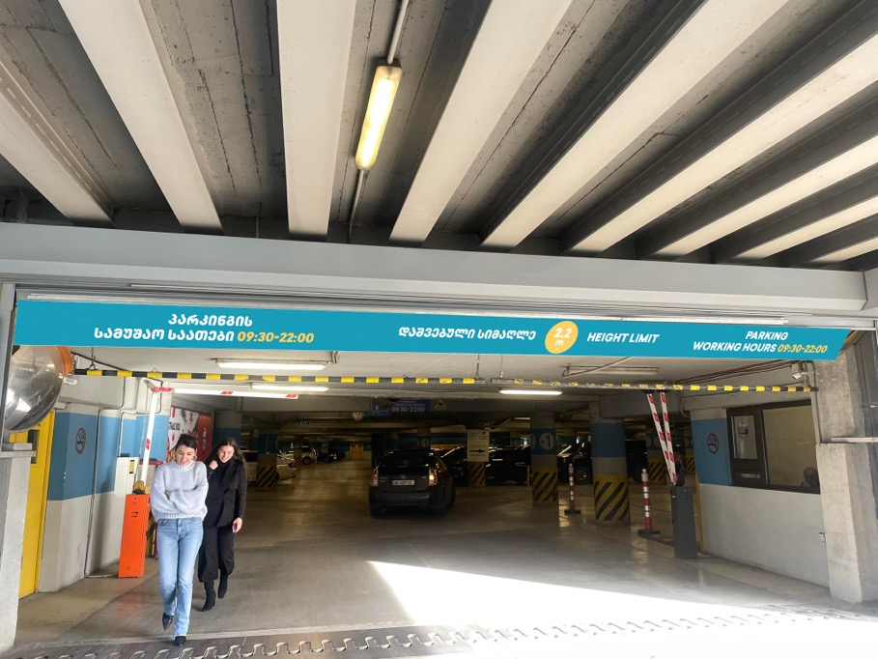
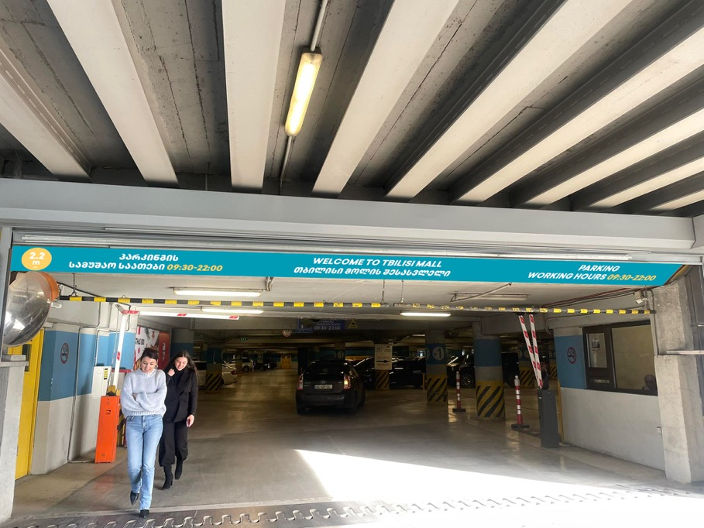
Features:
7*830*52 cm
Dibond/Pvc
1 pc

Slide 29
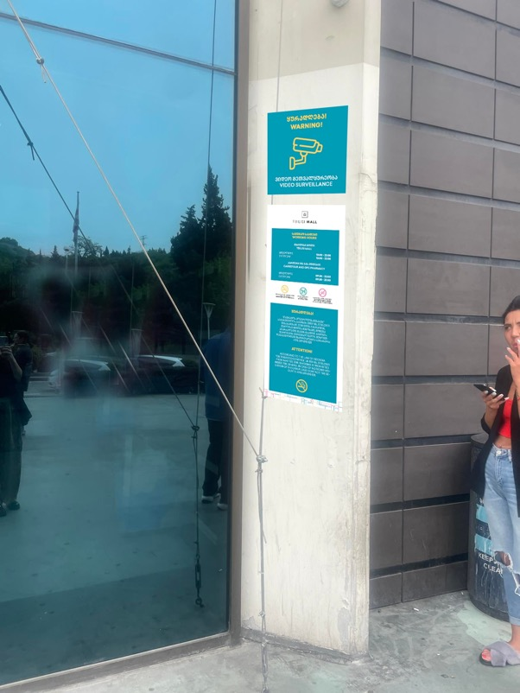
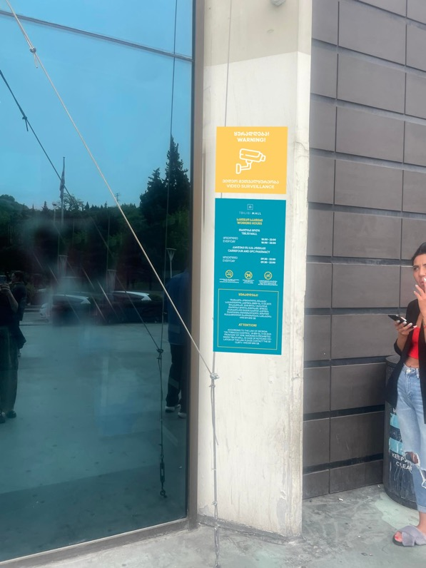
Features:
The previous stickers together

Slide 30
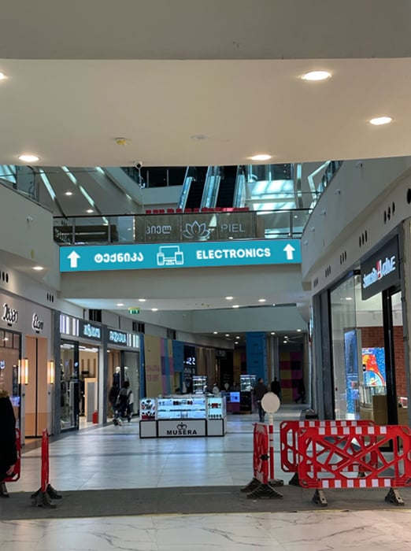
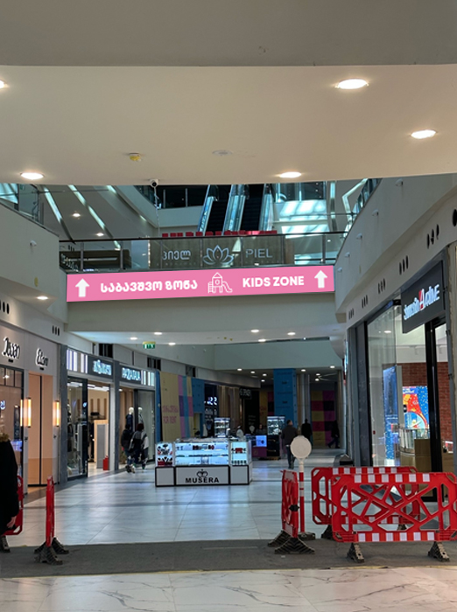
Features:
71*5.5*760 cm
Pvc
3 pcs

Slide 31
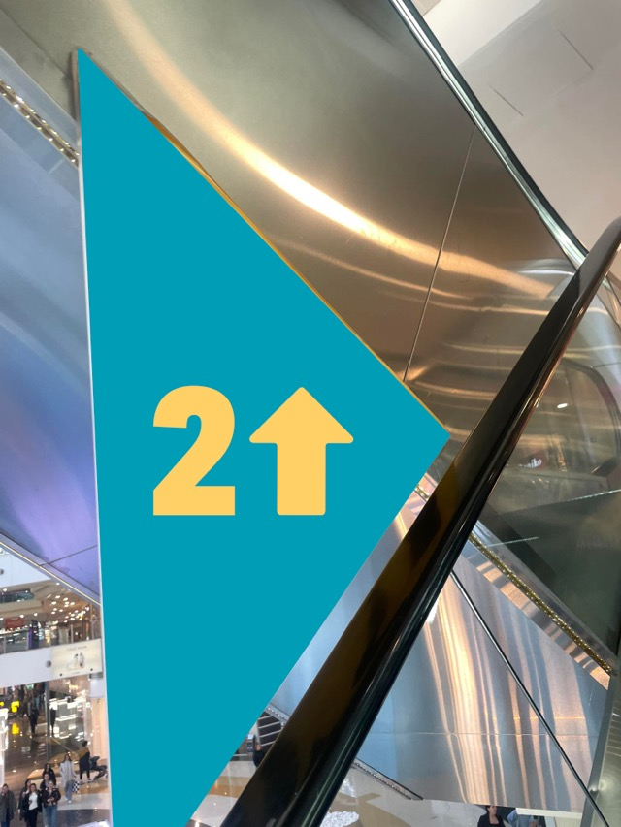
Features:
Triangle arrows - orgmina should remain and sticking
Width 56 cm, Height 29 cm, Height 63 cm
18 pcs

Slide 32
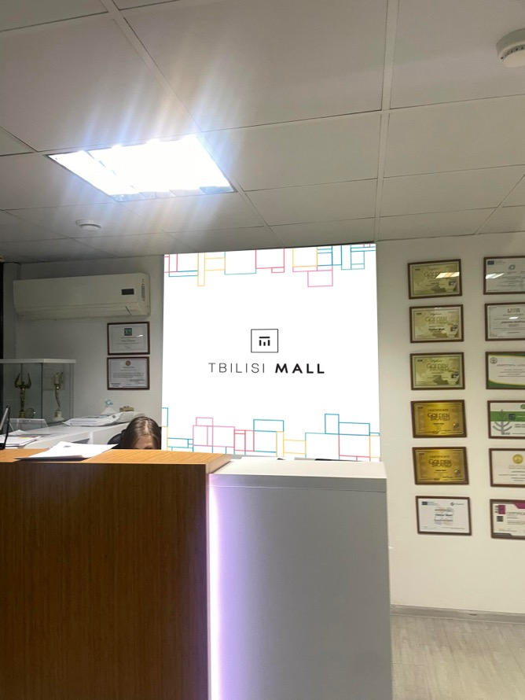
Features:
145*145 cm
PVC sticker
1 pc

Slide 33
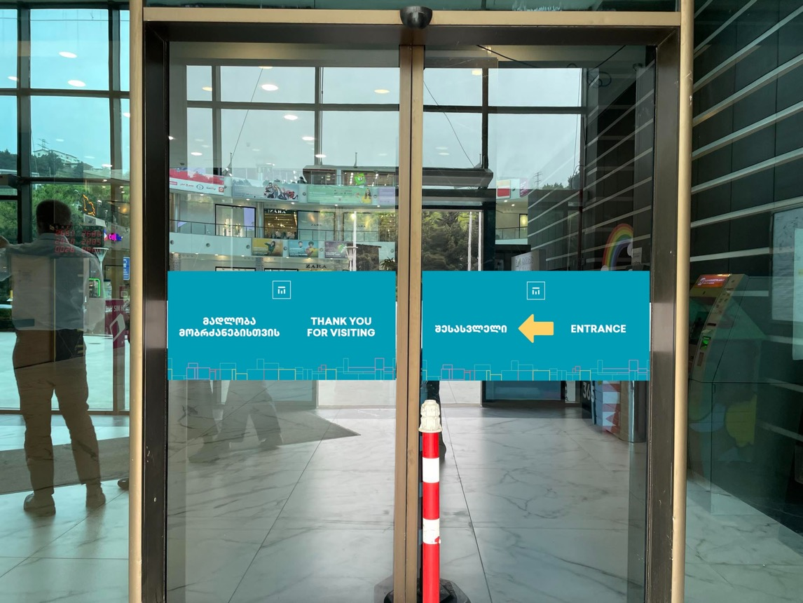
Features:
70*100 cm
Stickes

Slide 34
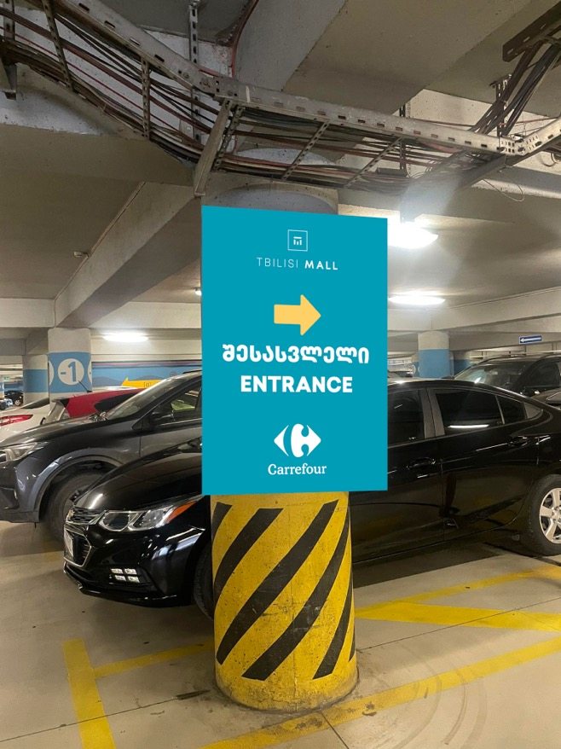
Features:
122*90 cm
Dibond/Pvc
3 pc
PARKING

Slide 35
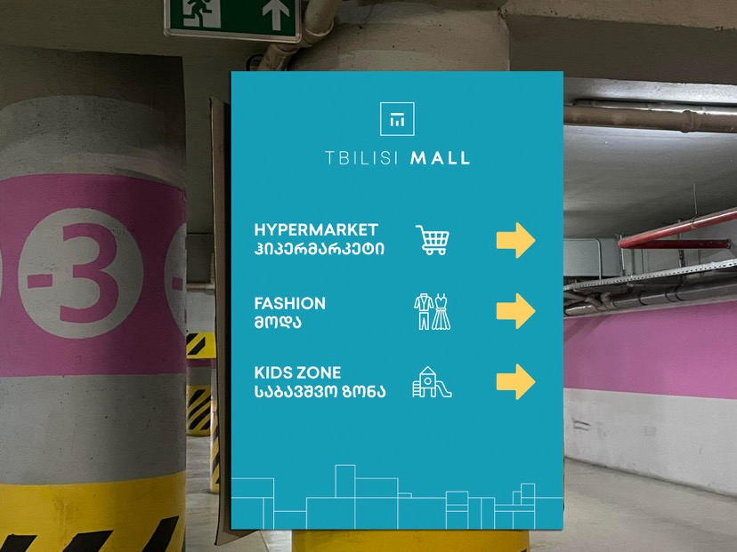
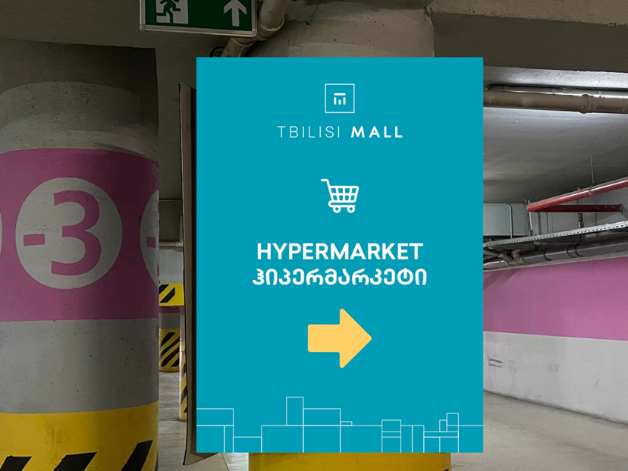
Features:
122*90 cm
Pvc sticker
12 pcs
PARKING
OLD
NEW

Slide 36
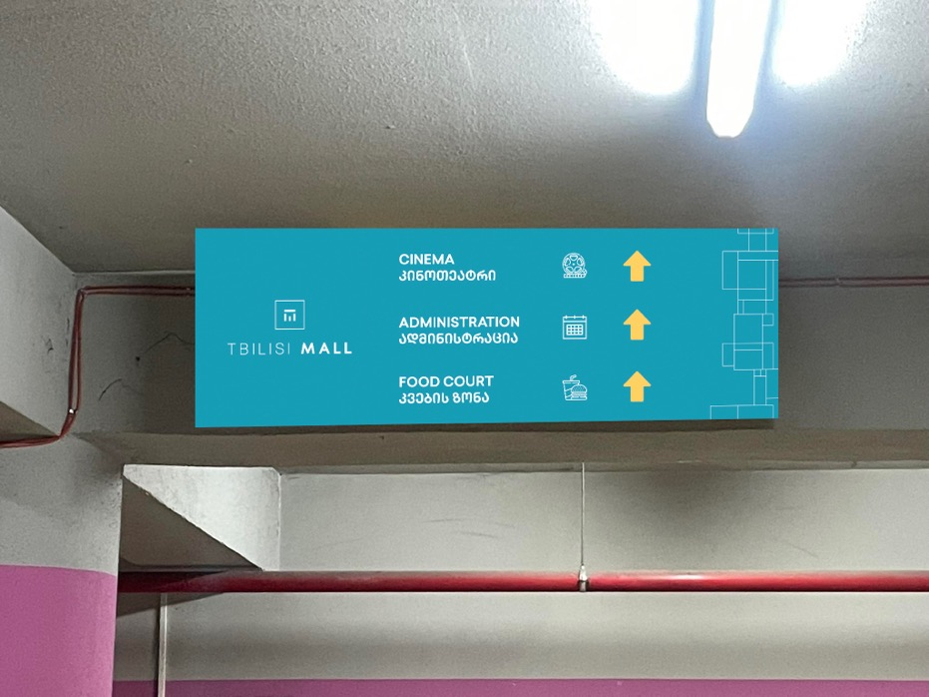
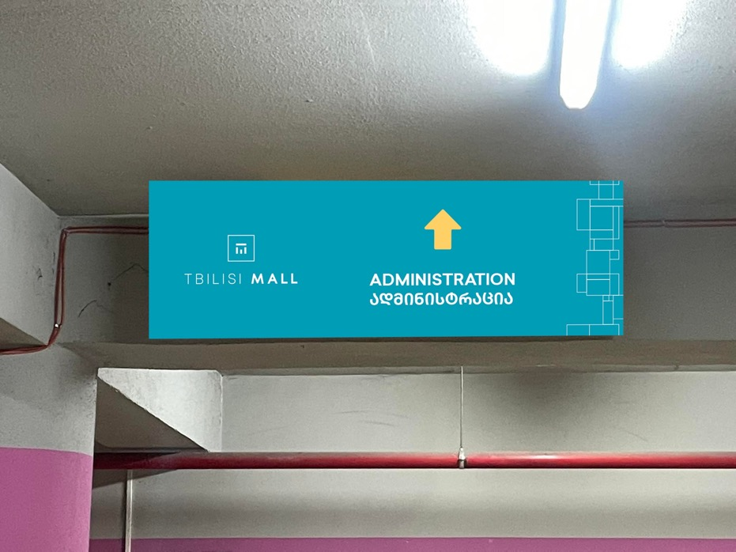
Features:
150*50 cm
PVC sticker
35 pc
PARKING
OLD
NEW

Slide 37
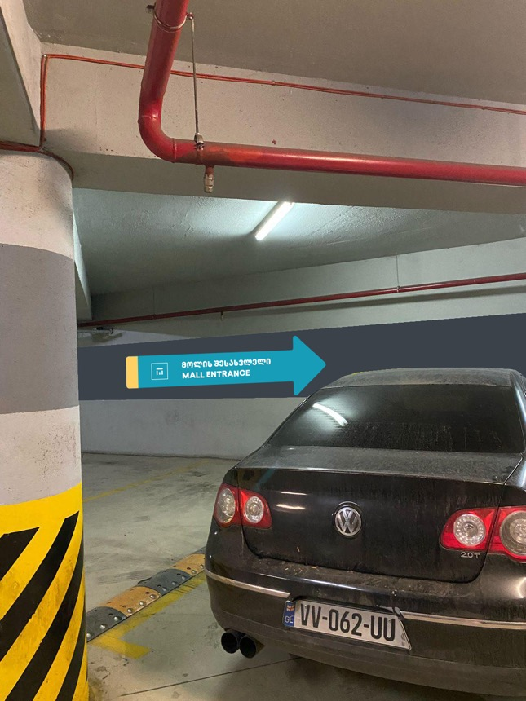
Features:
380*54*88 cm
PVC sticker
40 pcs
PARKING
Currently it is all yellow with black lettering. We want to paint in these colors or make a PVC sticker.

Slide 38
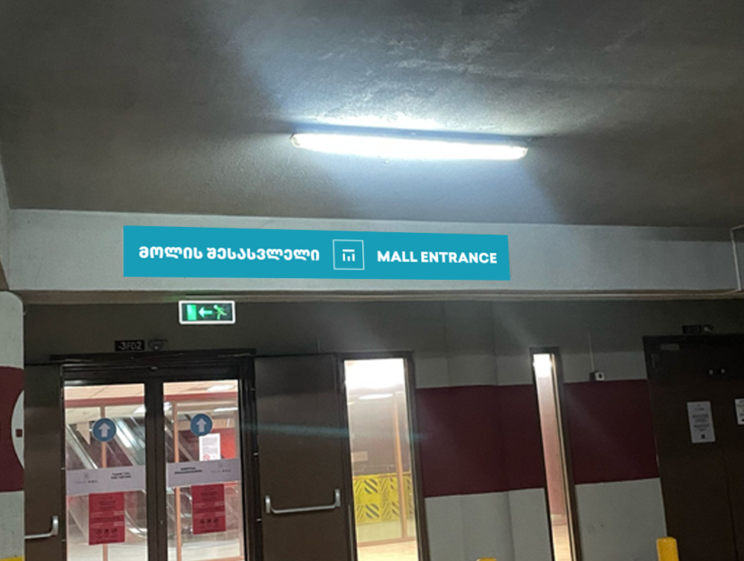
Features:
30*260 cm
PVC sticker
4 pcs
PARKING

Slide 39
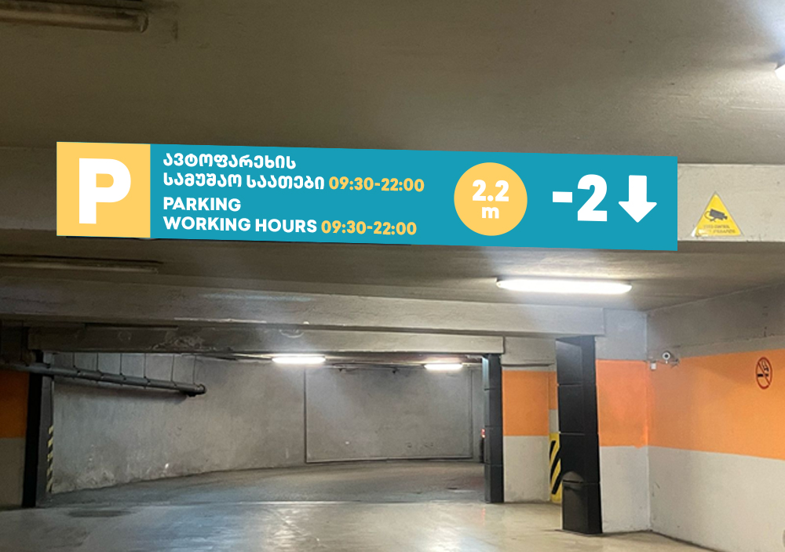
Features:
50*240 cm
PVC sticker
3 pcs
PARKING

Slide 40
Thank you.

